Slide 1
ELK - docker compose - stock ms - Examen
Raky mariam ly

Slide 2
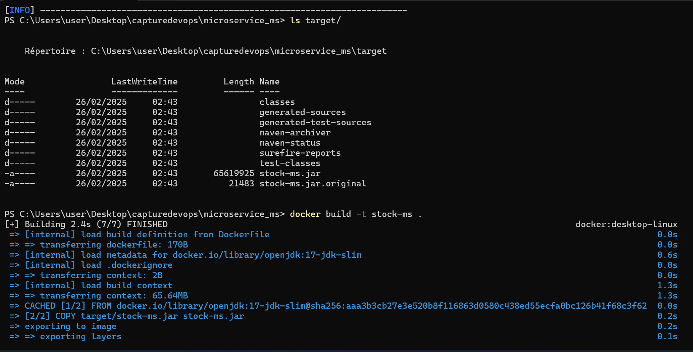

Slide 3
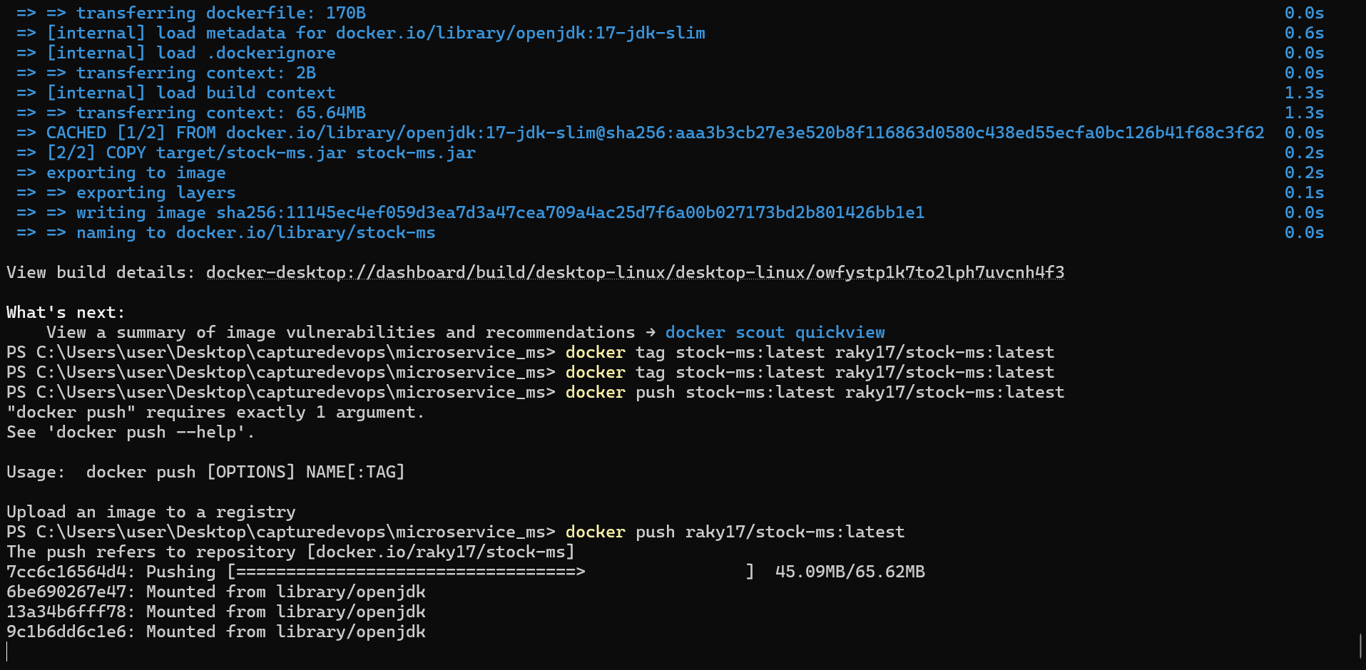

Slide 4
